Slide 1

CIT83104: ADVANCED WEB DESIGN AND DEVELOPMENT
By:
Mr. MANIRARORA Jean Marie Vianney
Course Code: CIT83104 & Name: ADVANCED WEB DESIGN AND DEVELOPMENT
1

Slide 2
CLASS INSTRUCTIONS
Please keep your phones aside during class sessions.
100% attendance is required for all classes.
Students are expected to practice effective time management.
Participation in all academic activities is mandatory, including:
Quizzes
In-class activities
Individual assignments
Group assignments
Presentations
Note: Failure to attend or participate in these activities may affect your overall performance.

Slide 3
MODULE OVERVIEW
Module Code: CIT83104
Title: Advanced Web Design and Development
Credits: 15
Year: 3rd Year
Prerequisite: Introduction to Web Design and Development
Total Study Hours: 150 (Lectures, Labs, Assignments, Self-study, etc.)

Slide 4
MODULE AIMS
Prepare students for professional web development
Blend theoretical knowledge with practical implementation
Focus on interactive, database-backed, and maintainable web applications

Slide 5
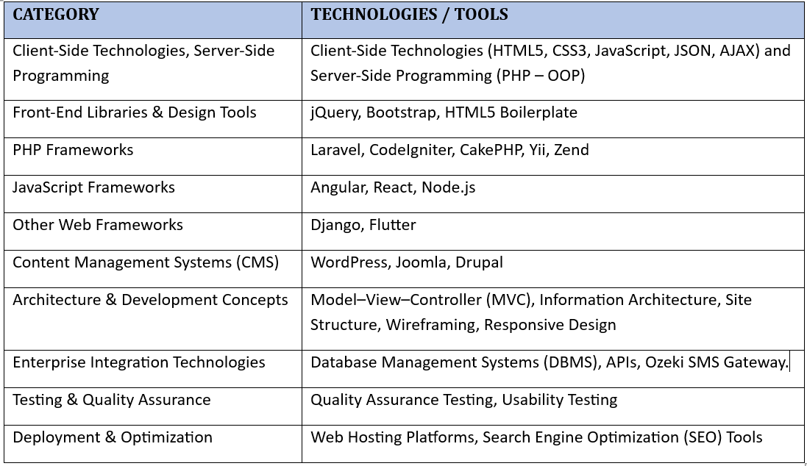
KEY TECHNOLOGIES & TOOLS

Slide 6


Slide 7
MODULE CONTENTS
HTML, CSS, JavaScript, layout techniques, and other industry-standard practices.
Scripting technologies to create dynamic and interactive websites.
Back-end interactivity with front-end to build web applications
Professional quality portfolio of web design work.
build Dynamic websites utilizing the most current versions of industry-standard applications and tools

Slide 8
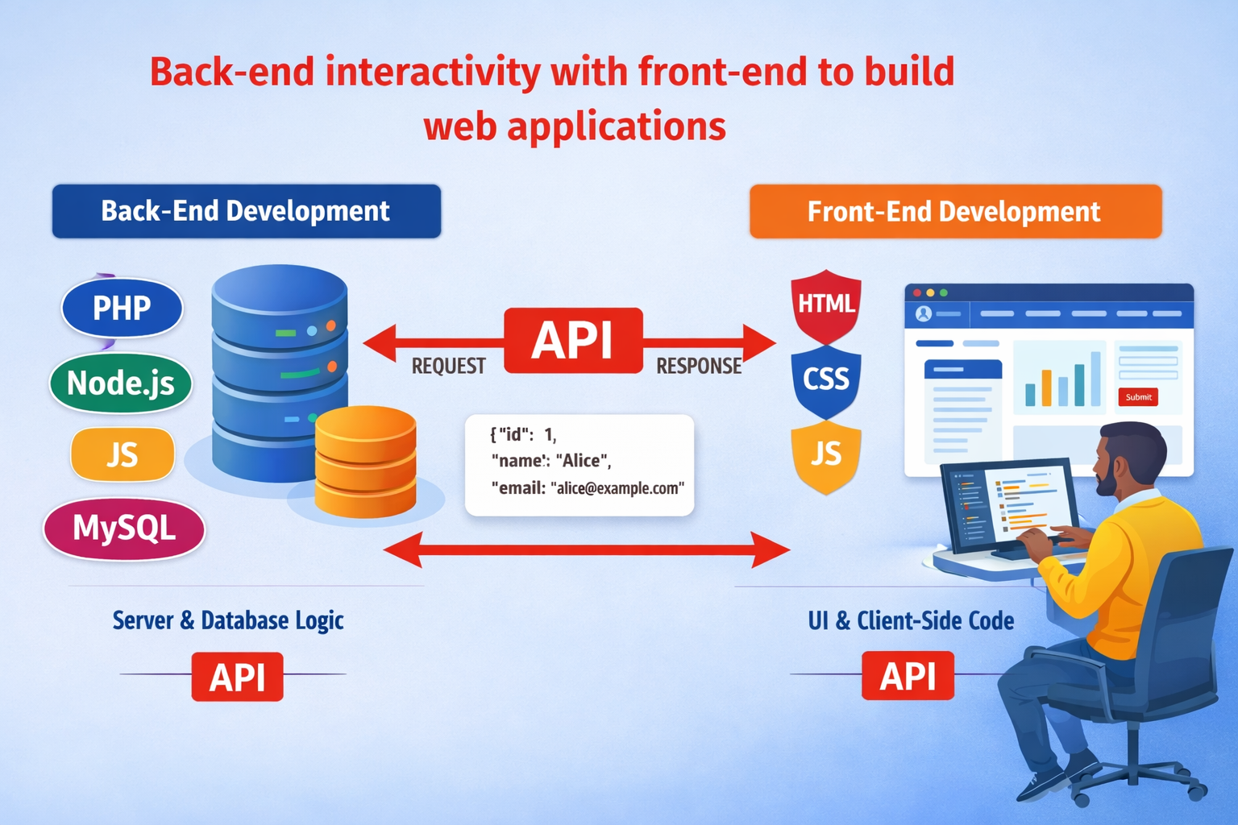
CHAP 3: Back-end interactivity with front-end to build web applications

Slide 9
1. Connecting PHP to MySQL
Application of Database Connection drives
✓ MySQLi
✓ PDO
MySQLi and PDO (PHP Data Objects) are two popular ways to interact with MySQL databases in PHP.
1. Definition of MySQLi
MySQLi (MySQL Improved) is a PHP extension used to interact with MySQL databases.
It allows PHP programs to:
Connect to a MySQL database
Insert data
Retrieve data
Update records
Delete records
MySQLi is an improved version of the older MySQL extension and provides better security and performance.

Slide 10
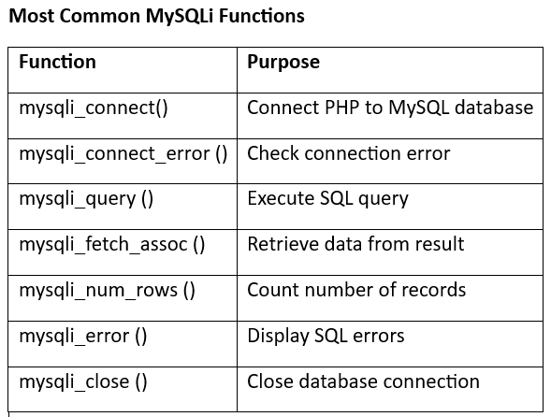

Slide 11
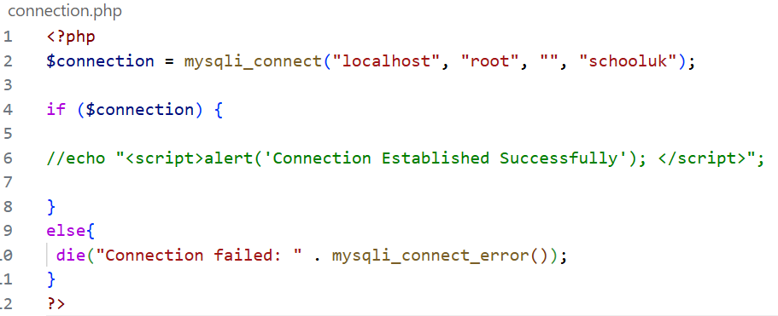
FILE NAME: connection.php
Database Connection
Before performing any database operation, PHP must connect to the MySQL database server.

Slide 12
Database Table Structure (students) inside database schooluk
Your MySQL table should look like:
CREATE TABLE students( studentid INT AUTO_INCREMENT PRIMARY KEY, names VARCHAR(100), address VARCHAR(100), phone VARCHAR(20) );

Slide 13
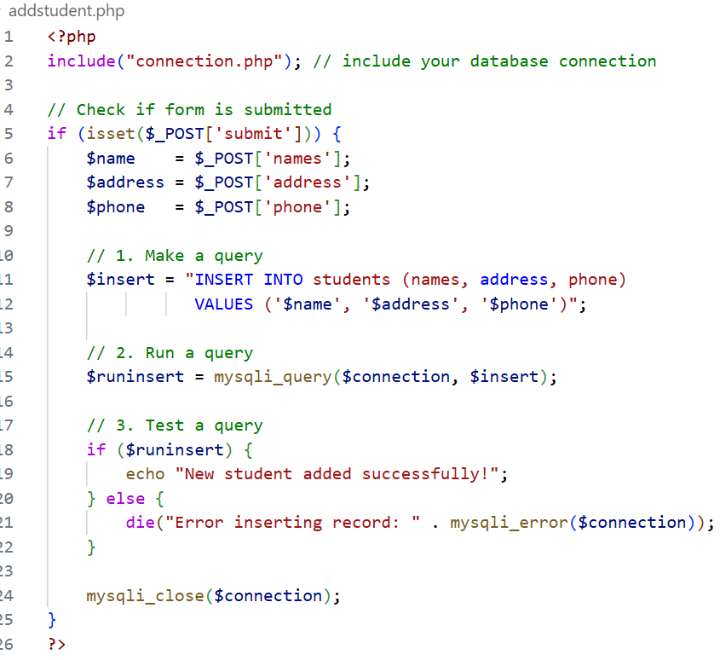
2. Insert records
Here’s a complete addstudent.php example that combines the form and the insert logic using isset() to check if the form was submitted. This way, everything is handled in one file:

Slide 14
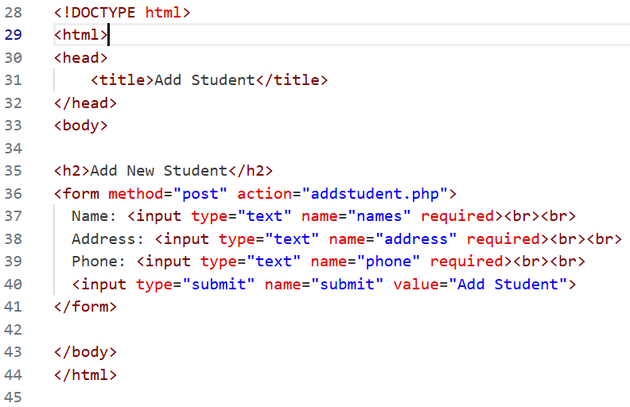

Slide 15
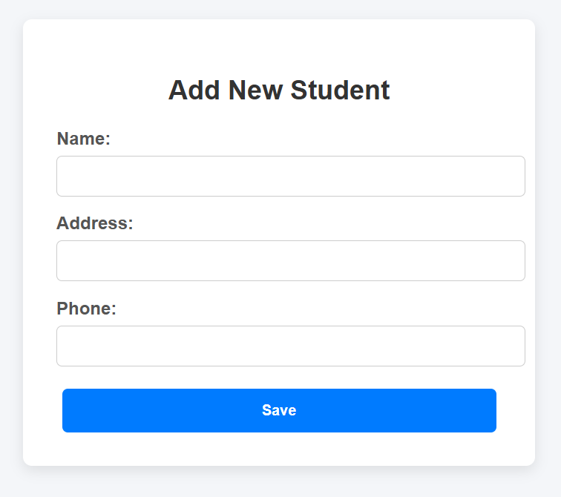

Slide 16
Notes: in PHP, include is one of several functions you can use to bring external files into your script. Here’s a breakdown of the main ones that work like include:
Example:
<?php
// include: warning if missing, script continues
include("connection.php");
// include_once: avoids multiple inclusions
include_once("connection.php");
// require: fatal error if missing, script stops
require("connection.php");
// require_once: fatal error if missing, but only once
require_once("connection.php");
?>

Slide 17
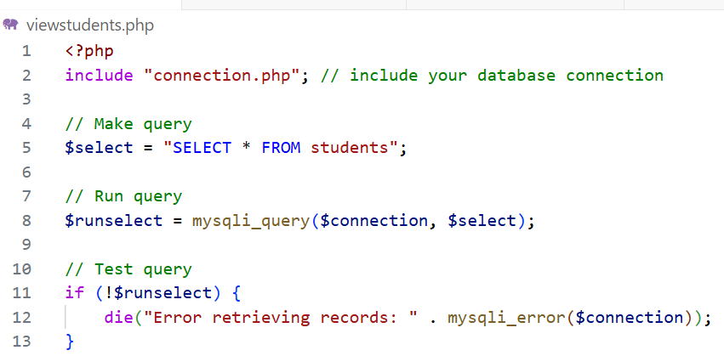
3. view records
PHP Code to Retrieve Students 'data
File name is viewstudents.php

Slide 18
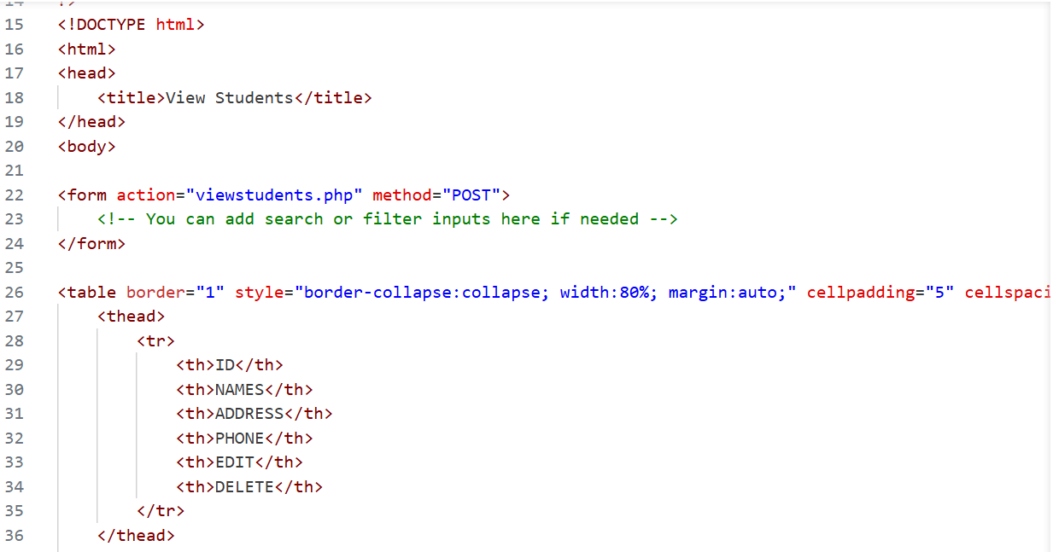

Slide 19
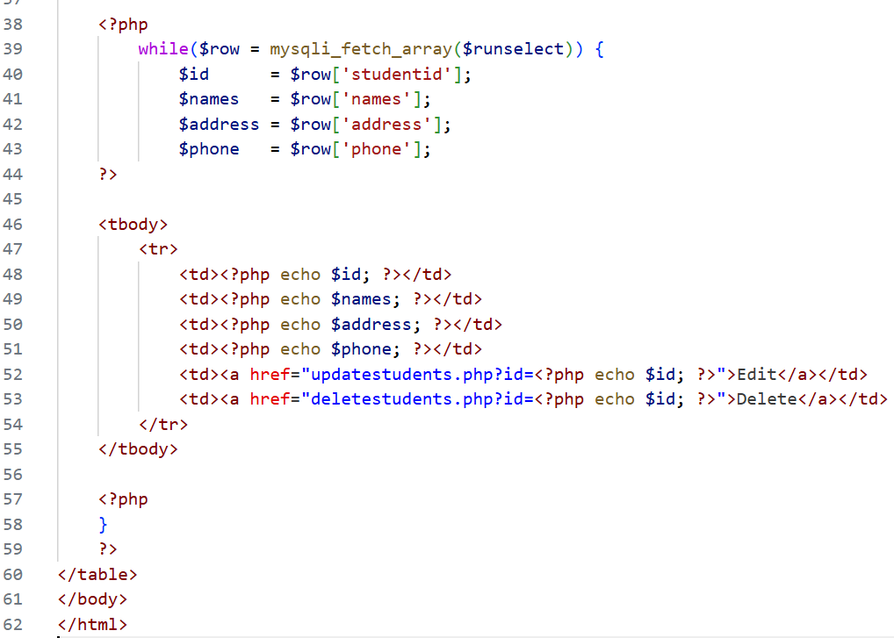

Slide 20
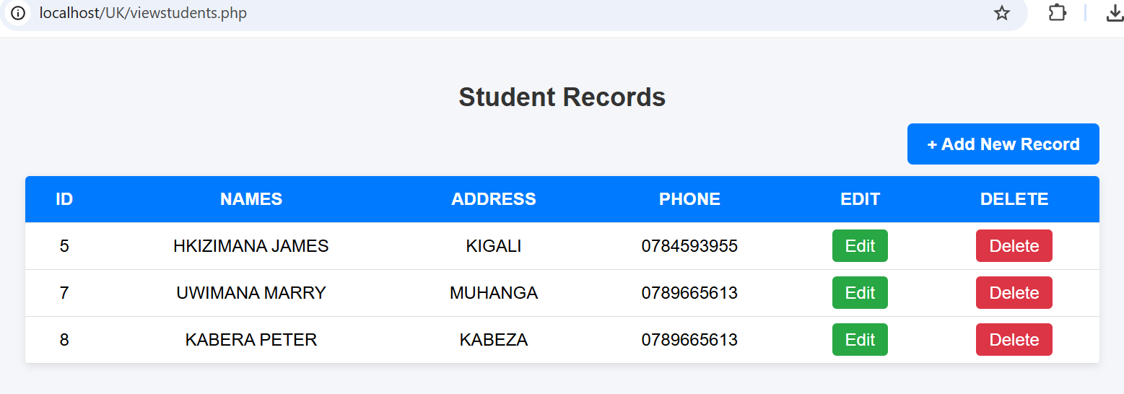

Slide 21
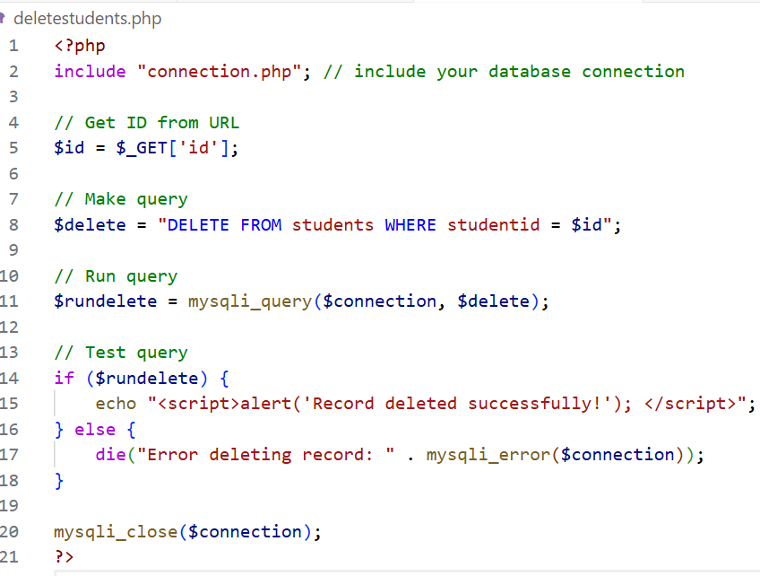
4. Delete Records
PHP Code to Delete Students 'data
File name is deletestudents.php

Slide 22
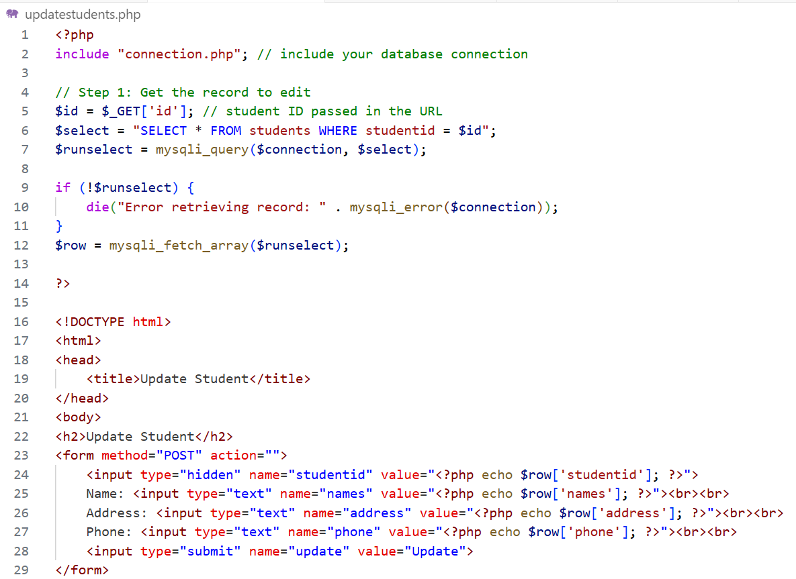
5. Update Records
PHP Code to Delete Students 'data
File name is updatestudents.php

Slide 23
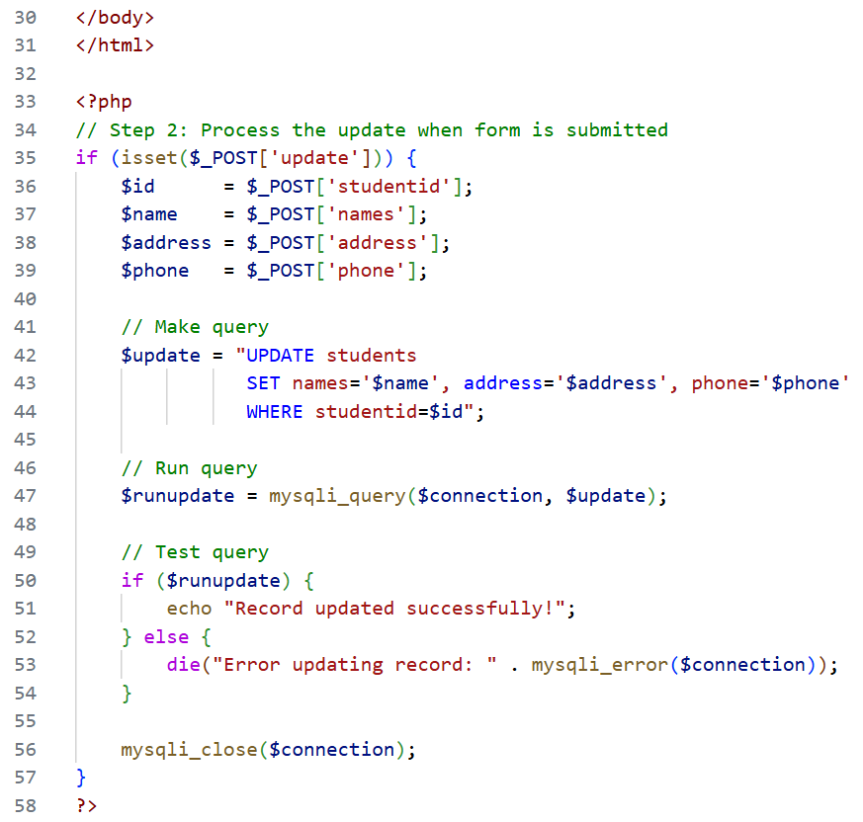

Slide 24
Dashboard design
A dashboard is a central interface or homepage in a system that provides users with a quick overview and easy access to important features, data, or tools. Think of it as a control panel for a web application or management system.

Slide 25
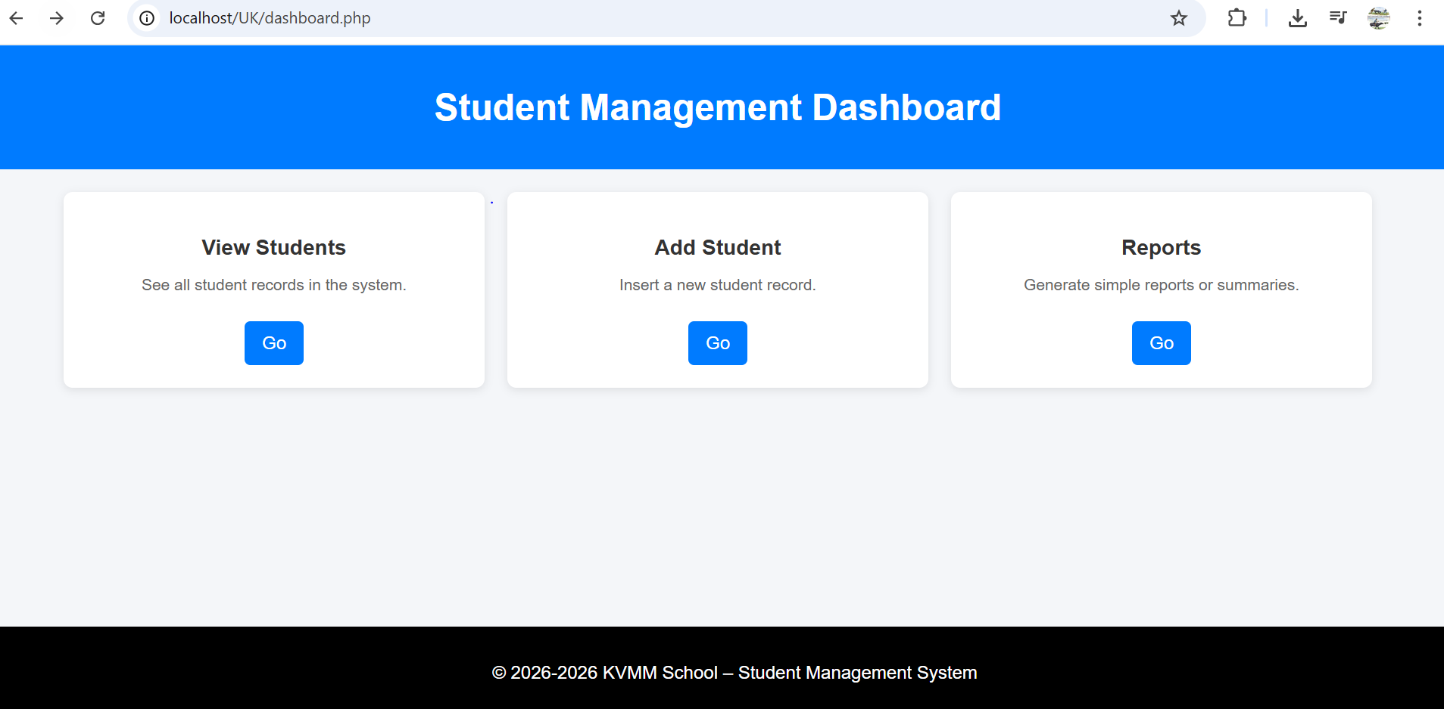

Slide 26
Dashboard Sample codes
<!DOCTYPE html>
<html lang="en">
<head>
<meta charset="UTF-8">
<meta name="viewport" content="width=device-width, initial-scale=1.0">
<title>Student Dashboard</title>
<style>
body {
font-family: Arial, sans-serif;
background: #f4f6f9;
margin: 0;
padding: 0;
}
header {
background: #007BFF;
color: #fff;
padding: 15px;
text-align: center;
}

Slide 27
.card h3 {
margin-bottom: 10px;
color: #333;
}
.card p {
color: #666;
font-size: 14px;
} .card a {
display: inline-block;
margin-top: 10px;
padding: 10px 15px;
background: #007BFF;
color: #fff;
border-radius: 5px;
text-decoration: none;
transition: background 0.3s;
}
.container {
width: 90%;
margin: 20px auto;
}
.cards {
display: flex;
justify-content: space-around;
flex-wrap: wrap;
gap: 20px;
}
.card {
background: #fff;
padding: 20px;
border-radius: 8px;
box-shadow: 0 2px 8px rgba(0,0,0,0.1);
flex: 1 1 250px;
text-align: center;
}

Slide 28
<header>
<h1>Student Management Dashboard</h1>
</header>
<div class="container">
<div class="cards">
<div class="card">
<h3>View Students</h3>
<p>See all student records in the system.</p>
<a href="viewstudents.php">Go</a>
</div>
<div class="card">
<h3>Add Student</h3>
<p>Insert a new student record.</p>
<a href="addstudent.php">Go</a>
</div>
<div class="card">
<h3>Reports</h3>
<p>Generate simple reports or summaries.</p>
<a href="reports.php">Go</a>
</div>
</div>
</div>
.card a:hover {
background: #0056b3;
}
footer {
text-align: center;
padding: 15px;
background: #eee;
position:fixed;
bottom: 0px;
width:100%;
background:black;
color:#fff;
</style>
</head>
<body>

Slide 29
<footer>
<p>&copy; 2026-<?php echo date('Y')?> KVMM School – Student Management System</p>
</footer> </body>
</html>

Slide 30
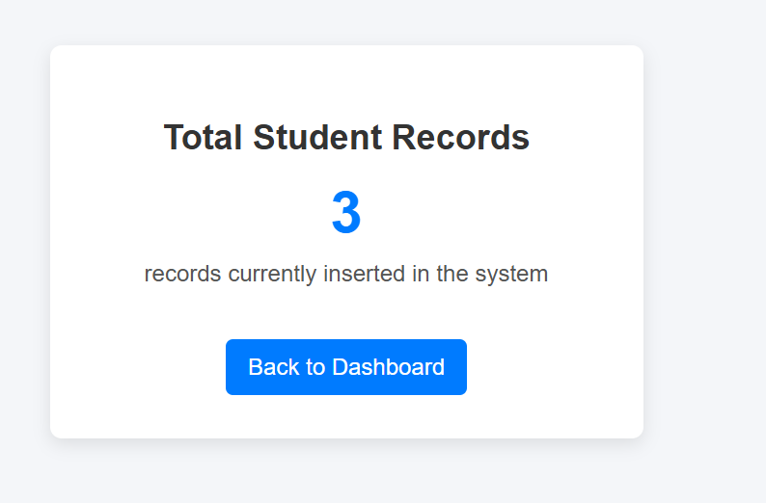

Slide 31
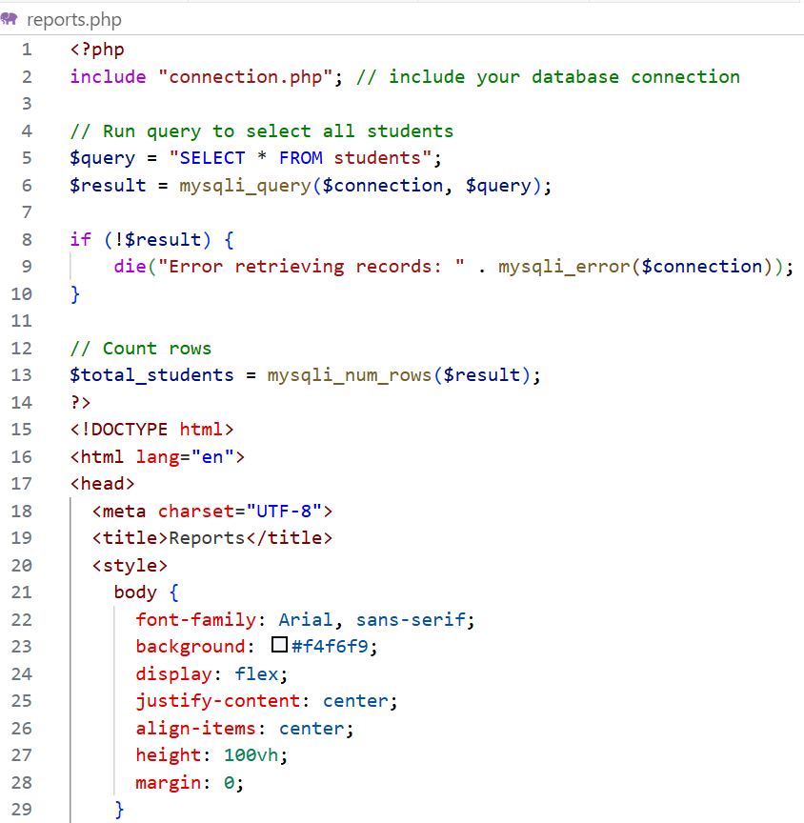

Slide 32
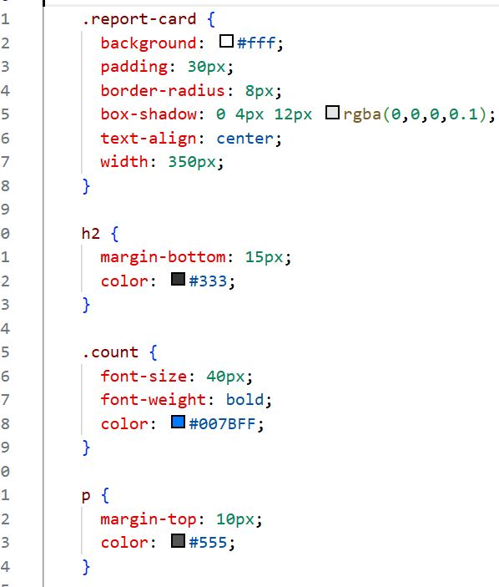
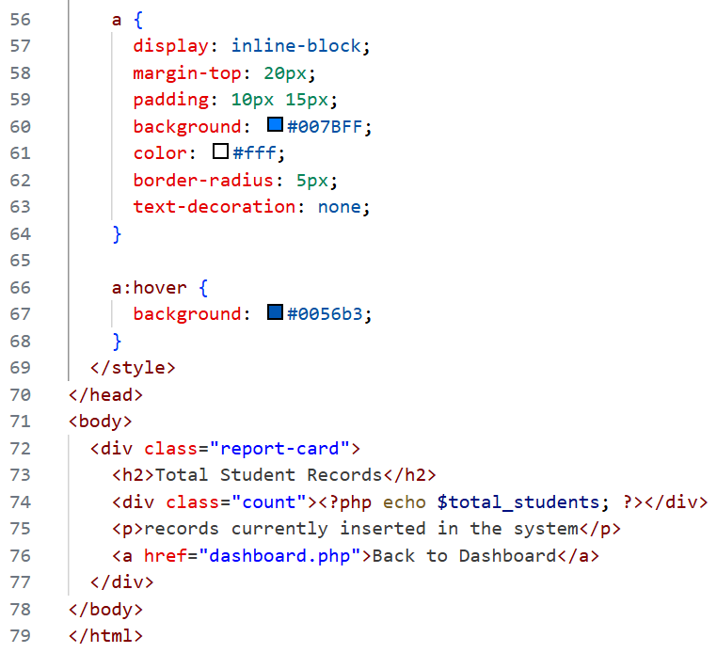

Slide 33
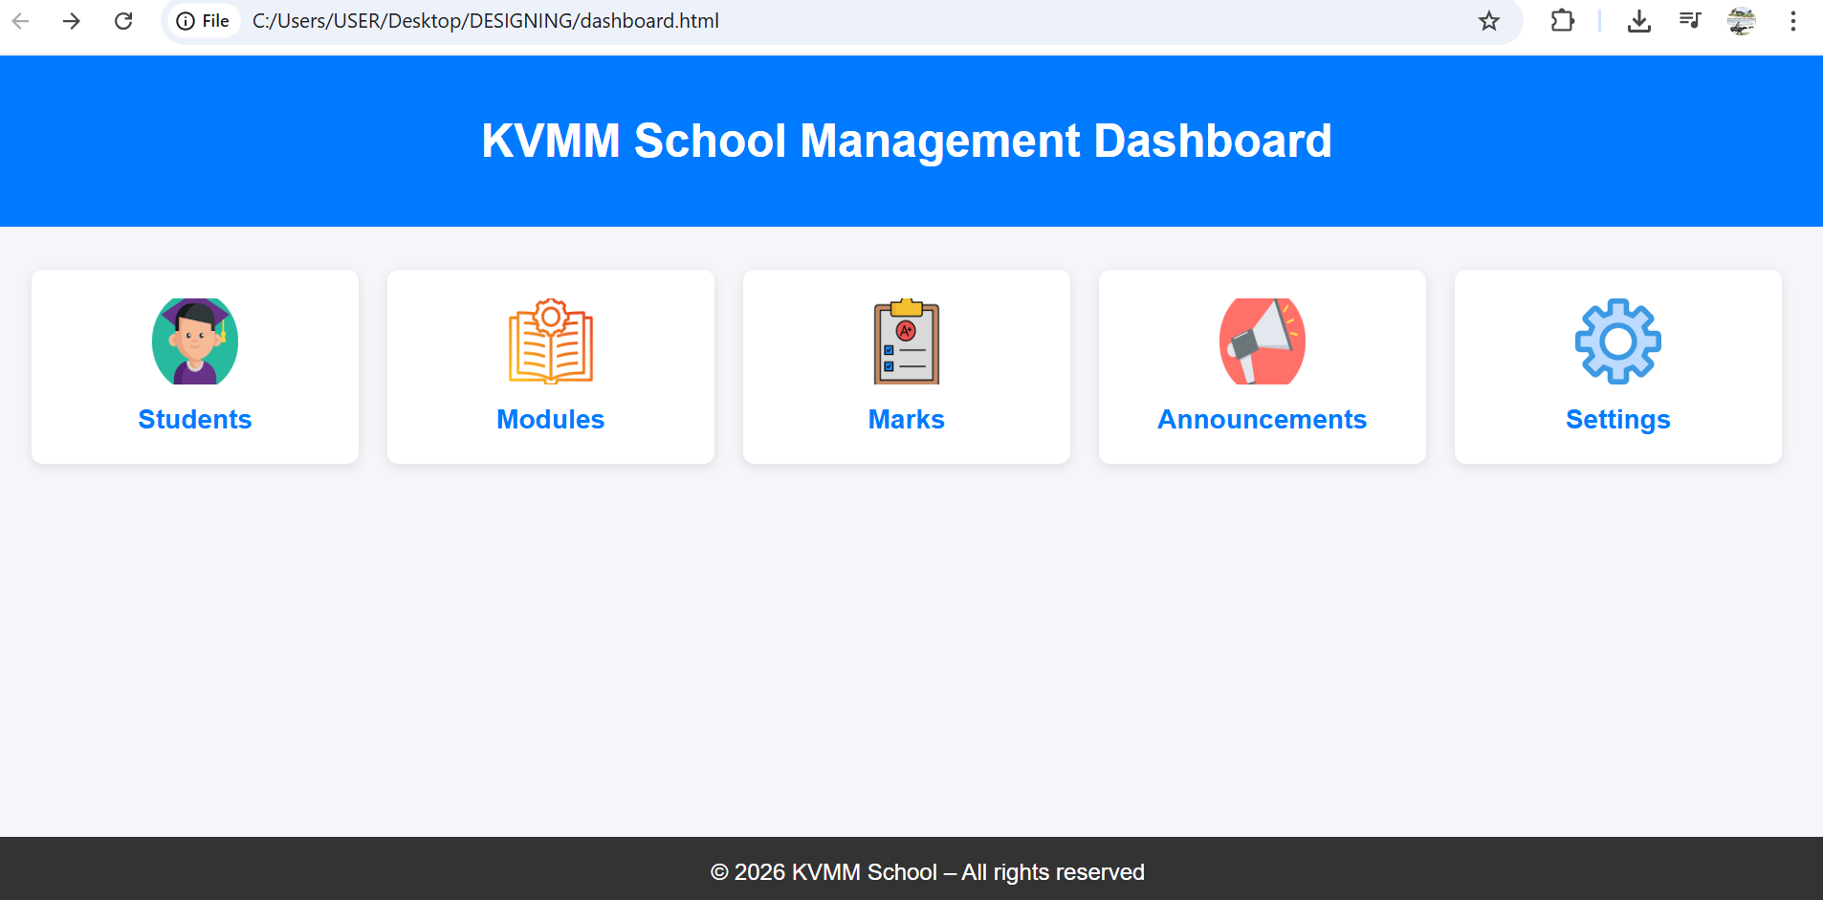
A simple responsive dashboard with links

Slide 34
Sample codes
footer {
background: #333;
color: #fff;
text-align: center;
padding: 15px;
position: fixed;
bottom: 0;
width: 100%;
}
.dashboard {
display: grid;
grid-template-columns: repeat(auto-fit, minmax(180px, 1fr));
gap: 20px;
padding: 30px;
}
.card-link {
text-decoration: none;
}
<!DOCTYPE html>
<html lang="en">
<head>
<meta charset="UTF-8">
<title>KVMM School Dashboard</title>
<style>
body {
font-family: Arial, sans-serif;
margin: 0;
background: #f4f6f9;
}
header {
background: #007BFF;
color: #fff;
padding: 20px;
text-align: center;
}

Slide 35
@media (max-width: 600px) {
.dashboard {
grid-template-columns: 1fr;
}
}
</style>
.card {
background: #fff;
padding: 20px;
border-radius: 8px;
box-shadow: 0 2px 8px rgba(0,0,0,0.1);
text-align: center;
transition: transform 0.3s, box-shadow 0.3s;
}
.card img {
width: 60px;
height: 60px;
margin-bottom: 10px;
}
.card h3 {
margin: 0;
color: #007BFF;
}
.card:hover {
transform: translateY(-5px);
box-shadow: 0 4px 12px rgba(0,0,0,0.2);
}

Slide 36
<a href="marks.php" class="card-link">
<div class="card">
<img src="marks.png" alt="Marks">
<h3>Marks</h3>
</div>
</a>
<a href="announcements.php" class="card-link">
<div class="card">
<img src="announcement.png" alt="Announcements">
<h3>Announcements</h3>
</div>
</a>
<a href="settings.php" class="card-link">
<div class="card">
<img src="settings.png" alt="Settings">
<h3>Settings</h3>
</div>
</a>
</div>
<footer>
&copy; 2026 KVMM School – All rights reserved
</footer>
</body>
</html>
</head>
<body>
<header>
<h1>KVMM School Management Dashboard</h1>
</header>
<div class="dashboard">
<a href="students.php" class="card-link">
<div class="card">
<img src="download.png" alt="Students">
<h3>Students</h3>
</div>
</a>
<a href="modules.php" class="card-link">
<div class="card">
<img src="module.png" alt="Modules">
<h3>Modules</h3>
</div>
</a>

Slide 37
A login form
A login form is a web form that allows users to enter their credentials (usually a username/email and a password) to gain access to a protected system, application, or website. It acts as the gateway to ensure only authorized users can enter.

Slide 38
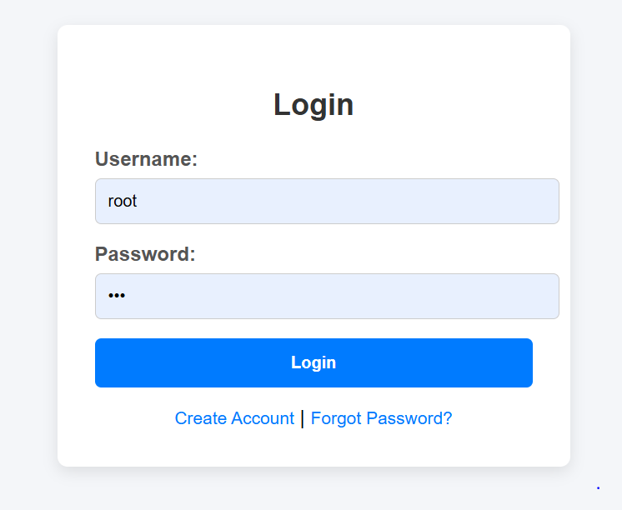
PHP login form

Slide 39
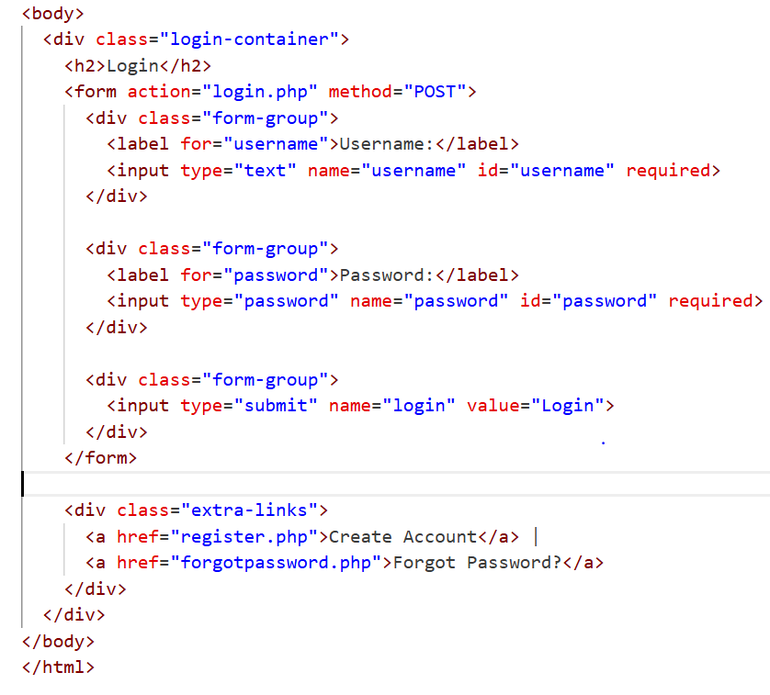
<Sample login form codes>

Slide 40
login.php (Simplified PHP)
<?php
include "connection.php"; // include your database connection
// Check if login button was clicked
if (isset($_POST['login'])) {
$username = $_POST['username'];
$password = $_POST['password'];
// Simple query (for demo purposes)
$sql = "SELECT * FROM users WHERE username='$username' AND password='$password'";
$result = mysqli_query($connection, $sql);
if (mysqli_num_rows($result) == 1) {
echo "Login successful! Welcome, " . $username;
// header("Location: dashboard.php"); // redirect if needed
} else {
echo "Invalid username or password.";
}
}
?>

Slide 41
END OF CHAP 3

